Slide 1
Chapt.4 Trees (I)

Slide 2
Rooted Trees
A rooted tree is a collection of elements called nodes, where one of the nodes is designated as the root node. (Only one root in a tree)
A rooted tree has a hierarchical（分层的） structure: the root on top, followed by the nodes adjacent to it right below, followed by the nodes adjacent to those next, and so on.
A
B
C
D
E
F
G
H
I
J
K
L
M
N

Slide 3

Recursive definition of a tree
A tree is a finite set of zero or more nodes such that:
There is a specially designated node r called the root
The remaining nodes are partitioned into n disjoint sets T₁, T₂, …T_{n} where each T_{i} is a tree whose root are connected by a directed edge from r.
T₁, T₂, …T_{n} are called subtrees of the root node.
A
B
C
D
E
F
G
H
I
J
K
L
M
N
Note:
➢ Subtrees must not connect together. Therefore every node in the tree is the root of some subtree.
➢ There are ? edges in a tree with N nodes.
➢ Normally the root is drawn at the top.
N-1

Slide 4
Terminologies
 degree of a node: number of subtrees of the node. For example, degree(A) = 3, degree(F) = 0.
A
B
C
D
E
F
G
H
I
J
 degree of a tree :
For example, degree of this tree = 3.
K
L
M
 parent : a node that has subtrees.
 children : the roots of the subtrees of a parent.
 siblings (brothers) : children of the same parent.
 leaf ( terminal node ) : a node with degree 0 (no children).

Slide 5
level
 path : a (unique) sequence of nodes n₁, n₂, …, n_{k} such that n_{i} is the parent of n_{i+1} for 1 ≤ i < k.
0
A
B
C
D
1
 length of path : number of edges on the path.
2
E
F
G
H
I
J
 depth (level) of n_{i} : length of the unique path from the root to n_{i}. Depth(root) = 0.
K
L
M
3
 height of n_{i} : length of the longest path from n_{i} to a leaf. Height(leaf) = 0, and height(D) = 2.
 height (depth) of a tree : height(root) = depth(deepest leaf).
 ancestors of a node : all the nodes along the path from the node up to the root.
 descendants of a node : all the nodes in its subtrees.

Slide 6
Notation
Graph notation
String notation
(the root comes first,
followed by a list of
subtrees)
A
( A )
B
C
D
( A ( B, C, D ) )
E
F
G
H
I
J
( A ( B ( E, F ), C ( G ), D ( H, I, J ) ) )
K
L
M
( A ( B ( E ( K, L ), F ), C ( G ), D ( H ( M ), I, J ) ) )
Graph notation of the tree
String notation of the tree

Slide 7
Implementation
So the size of each node
depends on the number of
branches.
Hmmm... That’s not good.
List Representation:
A
K
B
C
D
E
B
L
E
F
G
H
I
J
F
K
L
M
A
C
G
H
M
D
I
J

Slide 8
FirstChild-NextSibling Representation
Element
A
typedef struct TreeNode *PtrToNode;
Struct TreeNode
{
ElementType Element;
PtrToNode FirstChild;
PtrToNode NextSibling;
}
FirstChild
NextSibling
N
B
C
D
A
N
B
C
D
E
F
G
H
I
J
E
F
G
H
I
J
N
N
N
N
N
N
N
K
L
M
K
L
M
N
N
N
N
N
Note: The representation is not unique since the children in a tree can be of any order.

Slide 9
Binary Trees
A tree is a binary tree if every node has at most two children
The childern are distinguished as left child and right child, the order is fixed
1
1
3
2
7
3
7
5
8
9
5
8
9
10
4
6
10
4
6
11
12
11
12
Nonbinary tree
Binary tree

Slide 10
Samples of Binary Trees
A
A
A
Empty Binary Tree
B
B
B
C
A
C
Binary Tree with
Only One Node
D
E
F
G
D
Skewed Binary Tree
H
I
E
Complete Binary Tree

Slide 11
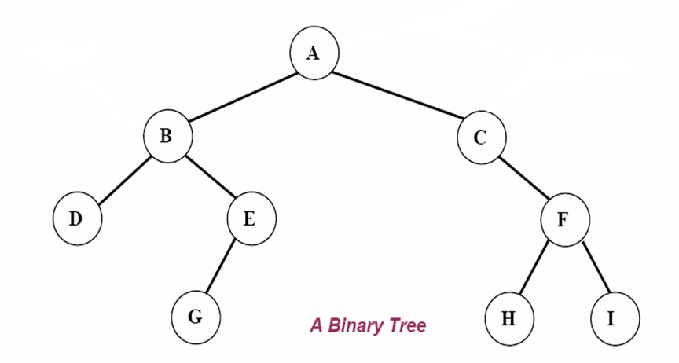
Binary-Tree Related Definitions
left subtree of node A
right subtree of node A
 left child & right child: The children of any node in a binary tree are ordered into a left child and a right child
left subtree: The tree made up of a left child (of a node x) and all its descendents
right subtrees are defined similarly

Slide 12
terms
degree of a node(tree)
level of a node (tree)
depth of a node(tree)
height of a node(tree)
A
B
C
D
E
F
G
H
I
J
K
L
M

Slide 13
Full BT vs. Complete BT
A full binary tree is a tree in which contains maximum number of nodes in all levels.
A complete binary tree is a binary tree in which every level, except possibly the last, is completely filled, and all nodes are as far left as possible.
A
A
A
B
C
B
C
B
C
D
E
F
G
D
E
F
G
L
M
N
O
D
E
F
H
I
J
K
H
I

Slide 14
Maximum Number of Nodes in BT
The maximum number of nodes on level l of a binary tree is , l>=0.
The maximum number of nodes in a binary tree of depth k is , k>=0.
2^{l}
2^{k+1}-1
Prove by induction:

Slide 15
Maximum Number of Nodes in BT
The number of nodes in a full binary tree of depth k is , k>=0.
A complete binary tree of deth k has at least nodes and at most nodes.
2^{k+1}-1
2^{k}
2^{k+1}-1

Slide 16

单选题
1分
For a n nodes binary tree,
What is the minimal depth of the tree?
A
n
B
n/2
C
Floor(logn)-1
D
Floor(logn)
提交

Slide 17
填空题
1分
For a n nodes binary tree, what is the maximal depth of the tree [填空1] ?
作答

Slide 18
Relations between Number of Leaf Nodes and Nodes of Degree 2
For any nonempty binary tree, if n₀ is the number of leaf nodes and n₂ the number of nodes of degree 2, then n₀=n₂+1
proof:
Let n and B denote the total number of nodes &
edges in T.
Let n₀, n₁, n₂ represent the nodes with no children,
single child, and two children respectively.
n = n₀+n₁+n₂, B+1=n, B =n₁+2n₂ ==> n₁+2n₂+1= n,
n1+2n₂+1= n₀+n₁+n₂ ==> n₀=n₂+1

Slide 19
Implementation of Binary Trees
Array representation
Linked list representation

Slide 20
Array Representation
Using an array (linear representation)
The nodes of the tree are stored sequentially in an array level by level, for each level ,from left to right. According to the following rules:

Slide 21
The root node is at location indexed with 1.
For any node with index i, 1<=i<=n, we have:
left_child(i) is at 2i , if 2i<=n.
If 2i>n, then i has no left child.
right_child(i) is at 2i+1 , if 2i +1 <=n.
If 2i +1 >n, then i has no right child.
parent(i) is at , if i!=1.
If i=1, i is at the root and has no parent.
i/2
A
A
B
C
B
D
E
F
D
E

Slide 22
Draws out the array representation of the following three binary trees:
[1]
[1]
[1]
A
A
A
[2]
[3]
[2]
[3]
B
B
B
C
[4]
[7]
[4]
[5]
[6]
[7]
C
C
D
E
F
G
[8]
[15]
D
D
[8]
[9]
[16]
[31]
H
I
E
E

Slide 23
填空题
1分
Suppose there is a complete binary tree with 900 nodes. The tree is saved in an array. The first node which has no right child is saved in the location with index [填空1] .
作答

Slide 24
Link Representation
typedef struct TreeNode *PtrToNode;
typedef struct PtrToNode Tree;
typedef struct TreeNode
{
ElemType data;
PtrToNode left, right;
};
data
left
data
right
left
right

Slide 25
T
a
T
a ⋀
b
b
c
d
⋀ c ⋀
d
e
f
⋀ e
⋀ f ⋀
⋀ g ⋀
g
(a) Binary tree
(b) Link representation

Slide 26
Binary Tree Traversals（遍历）
Traverse the tree: visit each exact once
Preorder traversal
Inorder traversal
Postorder traversal
Levelorder traversal
T
a
b
c
d
e
f
g

Slide 27
Preorder Traversal
Traversing a binary tree in preorder (depth-first order)
1. Visit the root.
2. Traverse the left subtree in preorder.
3. Traverse the right subtree in preorder.

Slide 28
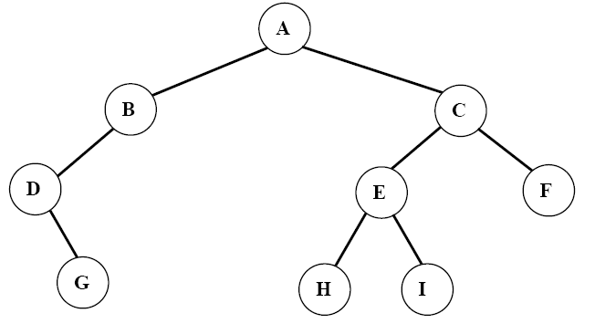
Preorder: ABDGCEHIF

Slide 29
Preorder Traversal (iterative version)
If the binary tree is empty, return. Otherwise, p=root:
⑴ visite *p；
⑵ q=p->right ，if q!=NULL，push q into a stack；
⑶ p=p->left ，if p!=NULL, do steps (1) to (3), otherwise do step (4)；
⑷ p=pop(stack) ，goto step(1)，till the stack is empty

Slide 30
Preorder Traversal (iterative version)
#define MAX_NODE 50
void PreorderTraverse(TreeNode * ptr)
{ TreeNode *Stack[MAX_NODE] , *q ;
if (ptr==NULL) printf(“ Binary Tree is Empty!\n”) ;
else { do
{ visit( ptr-> data ) ; q=ptr->right ;
if ( q!=NULL ) push(Stack, q) ;
ptr=ptr->left ;
if (ptr==NULL) { ptr=pop(Stack) ; }
}
while (ptr!=NULL) ;
}
}

Slide 31
Preorder Traversal (recursive version)
void preorder(Tree ptr)
/* preorder tree traversal */
{
if (ptr) {
printf(“%d”, ptr->data);
preorder(ptr->left);
predorder(ptr->right);
}
}

Slide 32
Inorder Traversing
Traversing a binary tree in inorder
(or symmetric order)
1. Traverse the left subtree in inorder.
2. Visit the root.
3. Traverse the right subtree in inorder.

Slide 33
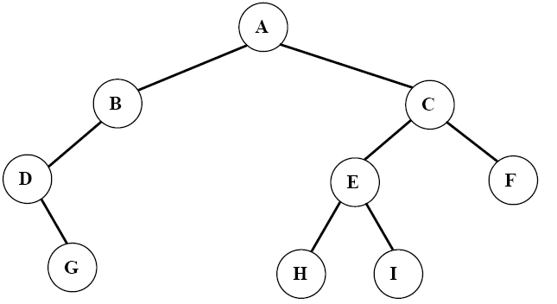
Inorder: DGBAHEICF

Slide 34
Inorder Traversal (iterative version)
#define MAX_NODE 50
void InorderTraverse( TreeNode *ptr)
{ TreeNode *Stack[MAX_NODE];
int top=0 , bool=1 ;
if (ptr==NULL) break ;
for(;bool!=0;)
{ for(;ptr!=NULL;)
{ stack[++top]=ptr ; ptr=ptr->left ; }
if (top==0)
bool=0 ;
else { ptr=stack[top] ; top-- ;
visit( ptr->data ) ; ptr=ptr->right ; }
}
}

Slide 35
Inorder Traversal (recursive version)
void inorder(Tree ptr)
/* inorder tree traversal */
{
if (ptr) {
inorder(ptr->left);
printf(“%d”, ptr->data);
indorder(ptr->right);
}
}

Slide 36
主观题
10分
Given a binary, suppose the preorder traversal sequence is
ABCDE
and inorder traversal sequence is
BDCEA
Draw out the binary tee.
正常使用主观题需2.0以上版本雨课堂
作答

Slide 37
Postorder Traversing
Traversing a binary tree in postorder
1. Traverse the left subtree in postorder.
2. Traverse the right subtree in postorder.
3. Visit the root

Slide 38
Postorder: GDBHIEFCA

Slide 39
Postorder Traversal (recursive version)
void postorder(Tree ptr)
/* postorder tree traversal */
{
if (ptr) {
postorder(ptr->left);
postdorder(ptr->right);
printf(“%d”, ptr->data);
}
}

Slide 40
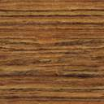

Expression Trees (syntax trees)
+
〖Example〗 Given an infix expression:
A + B ∗ C / D
A
/
∗
D
☞ Constructing an Expression Tree
(from postfix expression)
B
C
〖Example〗 ( a + b ) * ( c * ( d + e ) ) =
a b + c d e + * *
a
+
+
b
*
c
c
d
*
e
+
T₂
T₂
a
a
+
b
b
c
T₁
d
*
+
e
T₁
T₁
a
b
c
d
+
e
T₁
T₂
T₂
d
e

Slide 41
〖Example〗 Given an infix expression:
A + B ∗ C / D
+
A
/
Then inorder traversal ⇒ A + B ∗ C / D
postorder traversal ⇒ A B C ∗ D / +
preorder traversal ⇒ + A / ∗ B C D
∗
D
B
C

